Slide 1


Slide 2

Understand the importance of project quality management for information technology (IT) products and services
Define project quality management and understand how quality relates to various aspects of IT projects
Describe quality management planning and how quality and scope management are related
Discuss the importance of quality assurance
Explain the main outputs of the quality control process
Information Technology Project Management, Seventh Edition

Slide 3
Understand the tools and techniques for quality control, such as the Seven Basic Tools of Quality, statistical sampling, Six Sigma, and testing
Summarize the contributions of noteworthy quality experts to modern quality management
Describe how leadership, the cost of quality, organizational influences, expectations, cultural differences, and maturity models relate to improving quality in IT projects
Discuss how software can assist in project quality management
Information Technology Project Management, Seventh Edition

Slide 4

Many people joke about the poor quality of IT products
People seem to accept systems being down occasionally or needing to reboot their PCs
But quality is very important in many IT projects
Information Technology Project Management, Seventh Edition

Slide 5

In 1986, two hospital patients died after receiving fatal doses of radiation from a Therac 25 machine after a software problem caused the machine to ignore calibration data
In one of the biggest software errors in banking history, Chemical Bank mistakenly deducted about $15 million from more than 100,000 customer accounts
In August 2008, the Privacy Rights Clearinghouse stated that more than 236 million data records of U.S. residents have been exposed due to security breaches since January 2005
In March 2012, Consumer Reports listed several recalls on its Web site in less than 10 days, including LED lights overheating, five different models of cars having problems
Information Technology Project Management, Seventh Edition

Slide 6

The International Organization for Standardization (ISO) defines quality as “the degree to which a set of inherent characteristics fulfils requirements” (ISO9000:2000)
Other experts define quality based on:
  Conformance to requirements: The project’s processes and products meet written specifications
  Fitness for use: A product can be used as it was intended
Information Technology Project Management, Seventh Edition

Slide 7

Project quality management ensures that the project will satisfy the needs for which it was undertaken
Processes include:
  Planning quality manasgement: Identifying which quality standards are relevant to the project and how to satisfy them; a metric is a standard of measurement
  Performing quality assurance: Periodically evaluating overall project performance to ensure the project will satisfy the relevant quality standards
  Performing quality control: Monitoring specific project results to ensure that they comply with the relevant quality standards
Information Technology Project Management, Seventh Edition

Slide 8

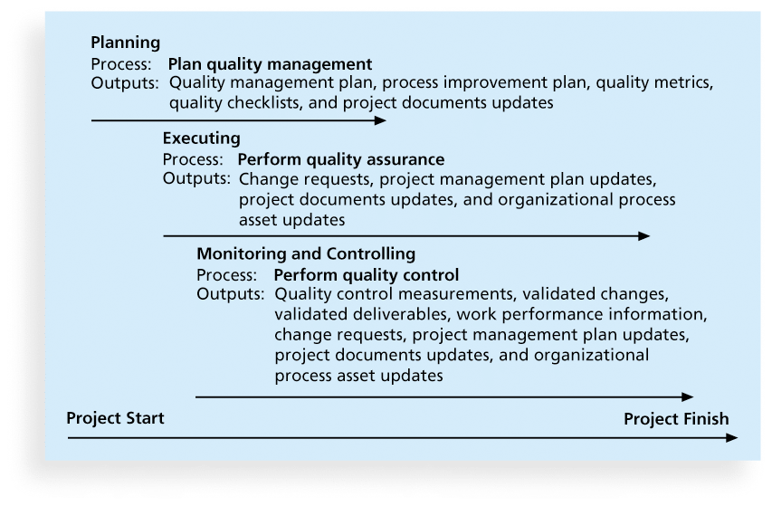
Information Technology Project Management, Seventh Edition

Slide 9

Implies the ability to anticipate situations and prepare actions to bring about the desired outcome
Important to prevent defects by:
  Selecting proper materials
  Training and indoctrinating people in quality
  Planning a process that ensures the appropriate outcome
Information Technology Project Management, Seventh Edition

Slide 10

Functionality is the degree to which a system performs its intended function
Features are the system’s special characteristics that appeal to users
System outputs are the screens and reports the system generates
Performance addresses how well a product or service performs the customer’s intended use
Reliability is the ability of a product or service to perform as expected under normal conditions
Maintainability addresses the ease of performing maintenance on a product
Information Technology Project Management, Seventh Edition

Slide 11

Project managers are ultimately responsible for quality management on their projects
Several organizations and references can help project managers and their teams understand quality
  International Organization for Standardization (www.iso.org)
  IEEE (www.ieee.org)
Information Technology Project Management, Seventh Edition

Slide 12

Quality assurance includes all the activities related to satisfying the relevant quality standards for a project
Another goal of quality assurance is continuous quality improvement
Benchmarking generates ideas for quality improvements by comparing specific project practices or product characteristics to those of other projects or products within or outside the performing organization
A quality audit is a structured review of specific quality management activities that help identify lessons learned that could improve performance on current or future projects
Information Technology Project Management, Seventh Edition

Slide 13

The main outputs of quality control are:
  Acceptance decisions
  Rework
  Process adjustments
There are Seven Basic Tools of Quality that help in performing quality control
Information Technology Project Management, Seventh Edition

Slide 14

Cause-and-effect diagrams trace complaints about quality problems back to the responsible production operations
They help you find the root cause of a problem
Also known as fishbone or Ishikawa diagrams
Can also use the 5 whys technique where you repeated ask the question “Why” (five is a good rule of thumb) to peel away the layers of symptoms that can lead to the root cause
Information Technology Project Management, Seventh Edition

Slide 15

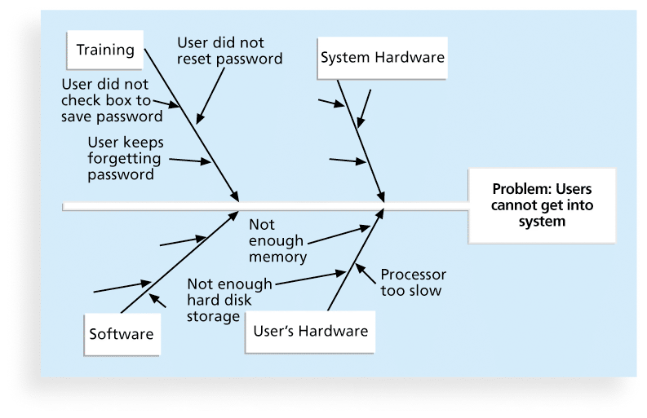
Information Technology Project Management, Seventh Edition

Slide 16

A control chart is a graphic display of data that illustrates the results of a process over time
The main use of control charts is to prevent defects, rather than to detect or reject them
Quality control charts allow you to determine whether a process is in control or out of control
  When a process is in control, any variations in the results of the process are created by random events; processes that are in control do not need to be adjusted
  When a process is out of control, variations in the results of the process are caused by non-random events; you need to identify the causes of those non-random events and adjust the process to correct or eliminate them
Information Technology Project Management, Seventh Edition

Slide 17

You can use quality control charts and the seven run rule to look for patterns in data
The seven run rule states that if seven data points in a row are all below the mean, above the mean, or are all increasing or decreasing, then the process needs to be examined for non-random problems
Information Technology Project Management, Seventh Edition

Slide 18

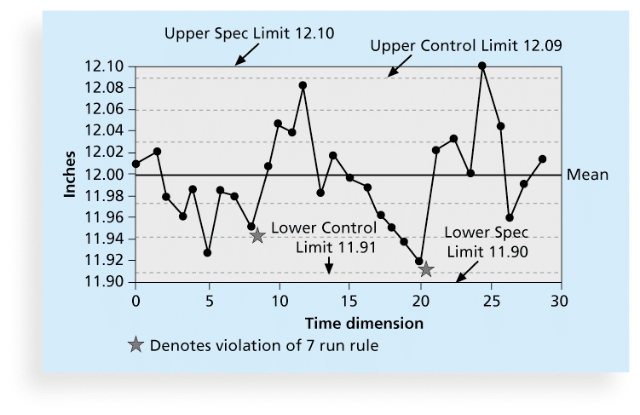
Information Technology Project Management, Seventh Edition

Slide 19

A checksheet is used to collect and analyze data
It is sometimes called a tally sheet or checklist, depending on its format
In the example in Figure 8-4, most complaints arrive via text message, and there are more complaints on Monday and Tuesday than on other days of the week
This information might be useful in improving the process for handling complaints
Information Technology Project Management, Seventh Edition

Slide 20

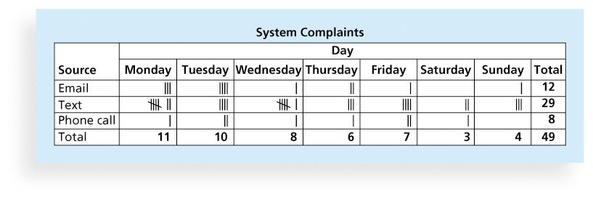
Information Technology Project Management, Seventh Edition

Slide 21

A scatter diagram helps to show if there is a relationship between two variables
The closer data points are to a diagonal line, the more closely the two variables are related
Information Technology Project Management, Seventh Edition

Slide 22

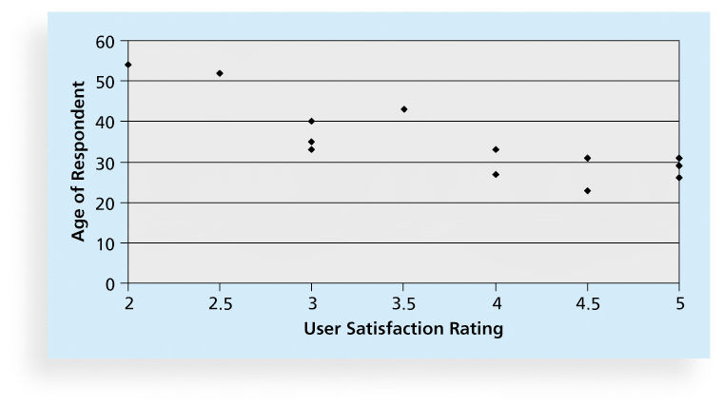
Information Technology Project Management, Seventh Edition

Slide 23

A histogram is a bar graph of a distribution of variables
Each bar represents an attribute or characteristic of a problem or situation, and the height of the bar represents its frequency
Information Technology Project Management, Seventh Edition

Slide 24

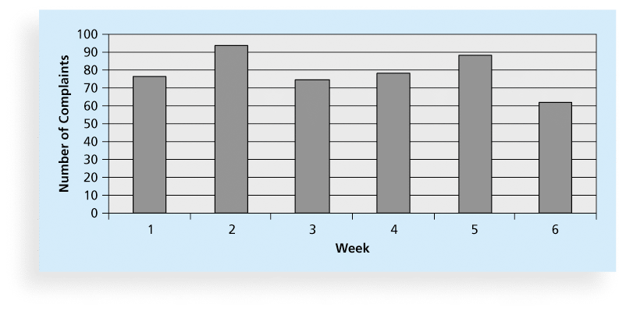
Information Technology Project Management, Seventh Edition

Slide 25

A Pareto chart is a histogram that can help you identify and prioritize problem areas
Pareto analysis is also called the 80-20 rule, meaning that 80 percent of problems are often due to 20 percent of the causes
Information Technology Project Management, Seventh Edition

Slide 26

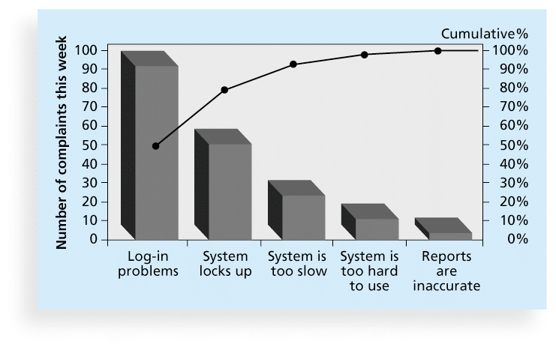
Information Technology Project Management, Seventh Edition

Slide 27

Flowcharts are graphic displays of the logic and flow of processes that help you analyze how problems occur and how processes can be improved
They show activities, decision points, and the order of how information is processed
Information Technology Project Management, Seventh Edition

Slide 28

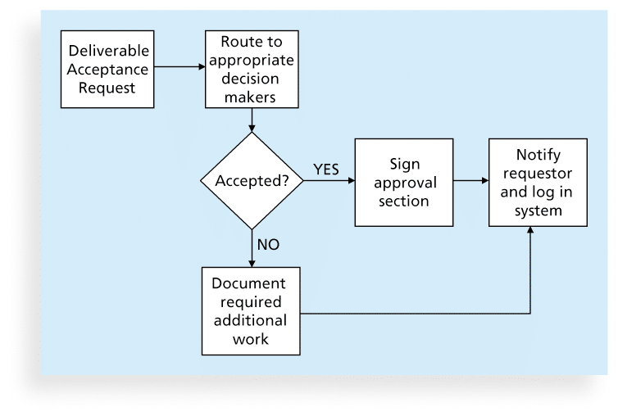
Information Technology Project Management, Seventh Edition

Slide 29

In addition to flowcharts, run charts are also used for stratification, a technique that shows data from a variety of sources to see if a pattern emerges
A run chart displays the history and pattern of variation of a process over time.
You can use run charts to perform trend analysis and forecast future outcomes based on historical results
Information Technology Project Management, Seventh Edition

Slide 30

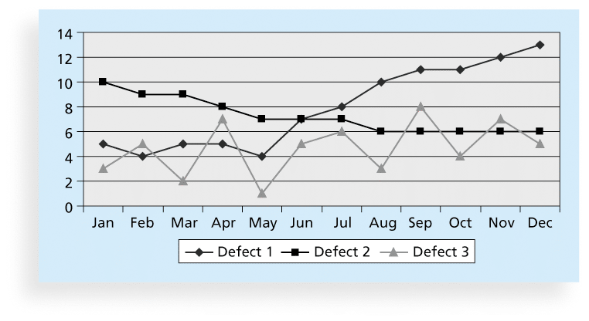
Information Technology Project Management, Seventh Edition

Slide 31

Statistical sampling involves choosing part of a population of interest for inspection
The size of a sample depends on how representative you want the sample to be
Sample size formula:
  Sample size = .25 X (certainty factor/acceptable error)²
Be sure to consult with an expert when using statistical analysis
Information Technology Project Management, Seventh Edition

Slide 32

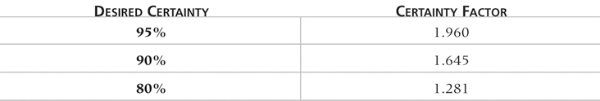
Information Technology Project Management, Seventh Edition

Slide 33

Six Sigma is “a comprehensive and flexible system for achieving, sustaining, and maximizing business success. Six Sigma is uniquely driven by close understanding of customer needs, disciplined use of facts, data, and statistical analysis, and diligent attention to managing, improving, and reinventing business processes”*
*Pande, Peter S., Robert P. Neuman, and Roland R. Cavanagh, The
Six Sigma Way, New York: McGraw-Hill, 2000, p. xi.
Information Technology Project Management, Seventh Edition

Slide 34

The target for perfection is the achievement of no more than 3.4 defects per million opportunities
The principles can apply to a wide variety of processes
Six Sigma projects normally follow a five-phase improvement process called DMAIC
Information Technology Project Management, Seventh Edition

Slide 35
DMAIC is a systematic, closed-loop process for continued improvement that is scientific and fact based
DMAIC stands for:
  Define: Define the problem/opportunity, process, and customer requirements
  Measure: Define measures, then collect, compile, and display data
  Analyze: Scrutinize process details to find improvement opportunities
  Improve: Generate solutions and ideas for improving the problem
  Control: Track and verify the stability of the improvements and the predictability of the solution
Information Technology Project Management, Seventh Edition

Slide 36

It requires an organization-wide commitment.
Training follows the “Belt” system
Six Sigma organizations have the ability and willingness to adopt contrary objectives, such as reducing errors and getting things done faster
It is an operating philosophy that is customer focused and strives to drive out waste, raise levels of quality, and improve financial performance at breakthrough levels
Information Technology Project Management, Seventh Edition

Slide 37

Motorola, Inc. pioneered the adoption of Six Sigma in the 1980s and saved about $14 billion
Allied Signal/Honeywell saved more than $600 million a year by reducing the costs of reworking defects and improving aircraft engine design processes
After implementing the solutions recommended by a Six Sigma team for Baptist St. Anthony's Hospital in Amarillo, Texas, the percent of delayed cases in the radiology department dropped from 79 percent to 33 percent, delays decreased by 22 percent, and the number of orders missing or needing clarification dropped to zero from 11 percent
Information Technology Project Management, Seventh Edition

Slide 38

Joseph M. Juran stated, “All improvement takes place project by project, and in no other way”*
It’s important to select projects carefully and apply higher quality where it makes sense; companies that use Six Sigma do not always boost their stock values
As Mikel Harry puts it, “I could genetically engineer a Six Sigma goat, but if a rodeo is the marketplace, people are still going to buy a Four Sigma horse.”**
Six Sigma projects must focus on a quality problem or gap between the current and desired performance and not have a clearly understood problem or a predetermined solution
*“What You Need to Know About Six Sigma,” Productivity Digest (December 2001), p. 38.
**Clifford, Lee, “Why You Can Safely Ignore Six Sigma,” Fortune (January 22, 2001), p. 140.
Information Technology Project Management, Seventh Edition

Slide 39

The training for Six Sigma includes many project management concepts, tools, and techniques
For example, Six Sigma projects often use business cases, project charters, schedules, budgets, and so on
Six Sigma projects are done in teams; the project manager is often called the team leader, and the sponsor is called the champion
Information Technology Project Management, Seventh Edition

Slide 40

The term sigma means standard deviation
Standard deviation measures how much variation exists in a distribution of data
Standard deviation is a key factor in determining the acceptable number of defective units found in a population
Six Sigma projects strive for no more than 3.4 defects per million opportunities, yet this number is confusing to many statisticians
Information Technology Project Management, Seventh Edition

Slide 41
Using a normal curve, if a process is at six sigma, there would be no more than two defective units per billion produced
Six Sigma uses a scoring system that accounts for time, an important factor in determining process variations
Yield represents the number of units handled correctly through the process steps
A defect is any instance where the product or service fails to meet customer requirements
There can be several opportunities to have a defect
Information Technology Project Management, Seventh Edition

Slide 42

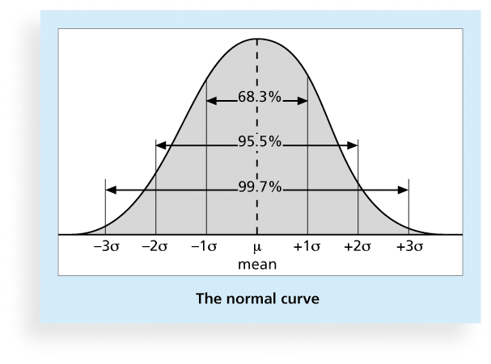
Information Technology Project Management, Seventh Edition

Slide 43

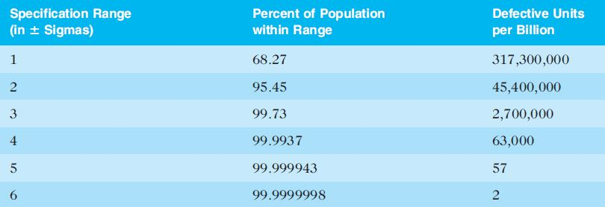
Information Technology Project Management, Seventh Edition

Slide 44

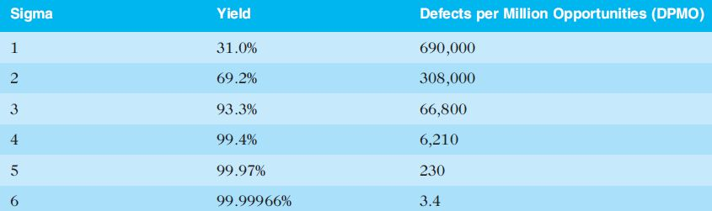
Information Technology Project Management, Seventh Edition

Slide 45

Six 9s of quality is a measure of quality control equal to 1 fault in 1 million opportunities
In the telecommunications industry, it means 99.9999 percent service availability or 30 seconds of down time a year
This level of quality has also been stated as the target goal for the number of errors in a communications circuit, system failures, or errors in lines of code
Information Technology Project Management, Seventh Edition

Slide 46

Many IT professionals think of testing as a stage that comes near the end of IT product development
Testing should be done during almost every phase of the IT product development life cycle
Information Technology Project Management, Seventh Edition

Slide 47

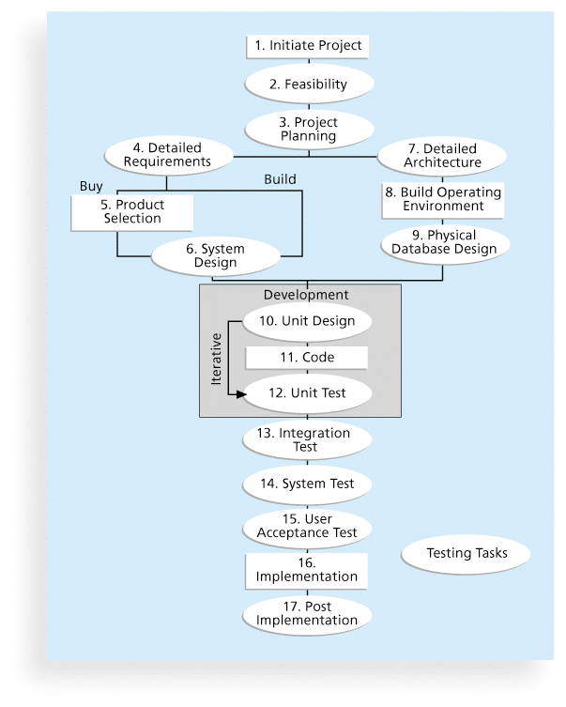
Information Technology Project Management, Seventh Edition

Slide 48
Unit testing tests each individual component (often a program) to ensure it is as defect-free as possible
Integration testing occurs between unit and system testing to test functionally grouped components
System testing tests the entire system as one entity
User acceptance testing is an independent test performed by end users prior to accepting the delivered system
Information Technology Project Management, Seventh Edition

Slide 49

Watts S. Humphrey, a renowned expert on software quality, defines a software defect as anything that must be changed before delivery of the program
Testing does not sufficiently prevent software defects because:
  The number of ways to test a complex system is huge
  Users will continue to invent new ways to use a system that its developers never considered
Humphrey suggests that people rethink the software development process to provide no potential defects when you enter system testing; developers must be responsible for providing error-free code at each stage of testing
Information Technology Project Management, Seventh Edition

Slide 50

Modern quality management:
  Requires customer satisfaction
  Prefers prevention to inspection
  Recognizes management responsibility for quality
Noteworthy quality experts include Deming, Juran, Crosby, Ishikawa, Taguchi, and Feigenbaum
Information Technology Project Management, Seventh Edition

Slide 51

Deming was famous for his work in rebuilding Japan and his 14 Points for Management
Juran wrote the Quality Control Handbook and ten steps to quality improvement
Crosby wrote Quality is Free and suggested that organizations strive for zero defects
Ishikawa developed the concepts of quality circles and fishbone diagrams
Taguchi developed methods for optimizing the process of engineering experimentation
Feigenbaum developed the concept of total quality control
Information Technology Project Management, Seventh Edition

Slide 52

The Malcolm Baldrige National Quality Award originated in 1987 to recognize companies that have achieved a level of world-class competition through quality management
Given by the President of the United States to U.S. businesses
Three awards each year in different categories:
  Manufacturing
  Service
  Small business
  Education and health care
Information Technology Project Management, Seventh Edition

Slide 53
ISO 9000 is a quality system standard that:
  Is a three-part, continuous cycle of planning, controlling, and documenting quality in an organization
  Provides minimum requirements needed for an organization to meet its quality certification standards
  Helps organizations around the world reduce costs and improve customer satisfaction
See www.iso.org for more information
Information Technology Project Management, Seventh Edition

Slide 54

Many car manufacturers are proud to show and sell their electric cars (Audi, Cadillac, Chevrolet, etc.), but many people might wonder if these cars are safe
Fortunately, ISO has updated a standard on safety features in electric and hybrid cars to prevent electricity-related injuries
ISO 6469-3:2011, Electrically propelled road vehicles – protection of persons against electric shock, will help the global market for electric cars
Information Technology Project Management, Seventh Edition

Slide 55

Several suggestions for improving quality for IT projects include:
  Establish leadership that promotes quality
  Understand the cost of quality
  Focus on organizational influences and workplace factors that affect quality
  Follow maturity models
Information Technology Project Management, Seventh Edition

Slide 56

As Joseph M. Juran said in 1945, “It is most important that top management be quality-minded. In the absence of sincere manifestation of interest at the top, little will happen below”*
A large percentage of quality problems are associated with management, not technical issues.
  *American Society for Quality (ASQ), (www.asqc.org/about/history/juran.html).
Information Technology Project Management, Seventh Edition

Slide 57

The cost of quality is the cost of conformance plus the cost of nonconformance
  Conformance means delivering products that meet requirements and fitness for use
  Cost of nonconformance means taking responsibility for failures or not meeting quality expectations
A study reported that software bugs cost the U.S. economy $59.6 billion each year and that one third of the bugs could be eliminated by an improved testing infrastructure
Information Technology Project Management, Seventh Edition

Slide 58
Prevention cost: Cost of planning and executing a project so it is error-free or within an acceptable error range
Appraisal cost: Cost of evaluating processes and their outputs to ensure quality
Internal failure cost: Cost incurred to correct an identified defect before the customer receives the product
External failure cost: Cost that relates to all errors not detected and corrected before delivery to the customer
Measurement and test equipment costs: Capital cost of equipment used to perform prevention and appraisal activities
Information Technology Project Management, Seventh Edition

Slide 59

A 2007 study by Nucleus Research Inc. estimated that spam management costs U.S. businesses more than $71 billion annually in lost productivity or $712 per employee
One e-mail security firm estimated that spam accounts for 95 percent of total e-mail volume worldwide
In 2008, Reuters reported that spyware and phishing cost consumers $7.1 billion in 2007, up from $2 billion the previous year
A 2011 report estimated that “10% of Americans have had their identities stolen, and on average, each of those individuals lost around $5,000. The cost to businesses worldwide adds up to a staggering $221 billion each year.”
Information Technology Project Management, Seventh Edition

Slide 60

Study by DeMarco and Lister showed that organizational issues had a much greater influence on programmer productivity than the technical environment or programming languages
Programmer productivity varied by a factor of one to ten across organizations, but only by 21 percent within the same organization
Study found no correlation between productivity and programming language, years of experience, or salary.
A dedicated workspace and a quiet work environment were key factors to improving programmer productivity
Information Technology Project Management, Seventh Edition

Slide 61

Project managers must understand and manage stakeholder expectations.
Expectations also vary by:
  Organization’s culture
  Geographic regions
Information Technology Project Management, Seventh Edition

Slide 62
Maturity models are frameworks for helping organizations improve their processes and systems
  The Software Quality Function Deployment Model focuses on defining user requirements and planning software projects
  The Software Engineering Institute’s Capability Maturity Model Integration is a process improvement approach that provides organizations with the essential elements of effective processes
Information Technology Project Management, Seventh Edition

Slide 63

CMMI levels, from lowest to highest, are:
  Incomplete
  Performed
  Managed
  Defined
  Quantitatively Managed
  Optimizing
Companies may not get to bid on government projects unless they have a CMMI Level 3
Information Technology Project Management, Seventh Edition

Slide 64
PMI released the Organizational Project Management Maturity Model (OPM3) in December 2003
Model is based on market research surveys sent to more than 30,000 project management professionals and incorporates 180 best practices and more than 2,400 capabilities, outcomes, and key performance indicators
Addresses standards for excellence in project, program, and portfolio management best practices and explains the capabilities necessary to achieve those best practices
Information Technology Project Management, Seventh Edition

Slide 65

OPM3 provides the following example to illustrate a best practice, capability, outcome, and key performance indicator:
  Best practice: Establish internal project management communities
  Capability: Facilitate project management activities
  Outcome: Local initiatives, meaning the organization develops pockets of consensus around areas of special interest
  Key performance indicator: Community addresses local issues
Information Technology Project Management, Seventh Edition

Slide 66

Spreadsheet and charting software helps create Pareto diagrams, fishbone diagrams, and so on
Statistical software packages help perform statistical analysis
Specialized software products help manage Six Sigma projects or create quality control charts
Project management software helps create Gantt charts and other tools to help plan and track work related to quality management
Information Technology Project Management, Seventh Edition

Slide 67

Project quality management ensures that the project will satisfy the needs for which it was undertaken
Main processes include:
  Plan quality
  Perform quality assurance
  Perform quality control
Information Technology Project Management, Seventh Edition

